Slide 1

Python
Modules

Slide 2

Modules
A module allows you to logically organize your Python code. Grouping related code into a module makes the code easier to understand and use. A module is a Python object with arbitrarily named attributes that you can bind and reference.
Simply, a module is a file consisting of Python code. A module can define functions, classes and variables. A module can also include runnable code.
www.skillslash.com

Slide 3
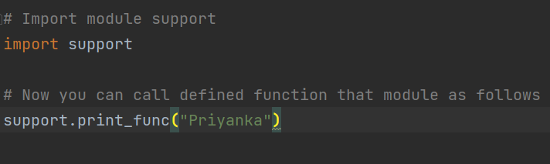
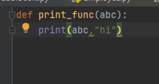
Example-
www.skillslash.com

Slide 4
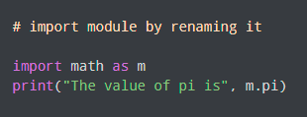
Import with renaming

Slide 5
The from...import Statement
Python's from statement lets you import specific attributes from a module into the current namespace. The from...import has the following syntax −
from modname import name1[, name2[, ... nameN]]
www.skillslash.com

Slide 6
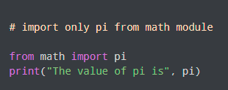
Example
Notes:
Create a module file: mymodule.py : It has a function and a dictionary
def greeting(name): print("Hello, " + name) person1 = { "name": "John", "age": 36, "country": "Norway" }
Import only one thing:
from mymodule import person1 print (person1["age"])

Slide 7
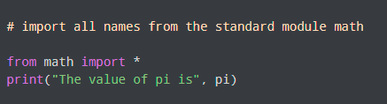
Import all names?

Slide 8
Import all names?

Slide 9
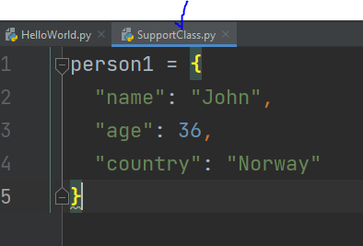
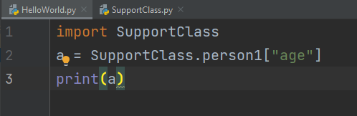
Accessing individual elements

Slide 10
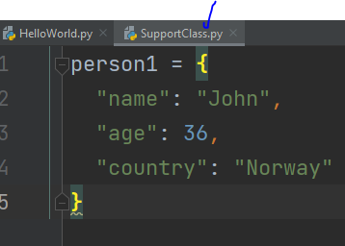
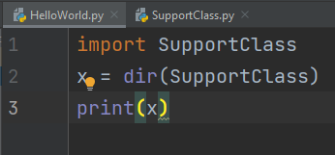
dir() method- built-in function to list all the function names (or variable names) in a module

Slide 11
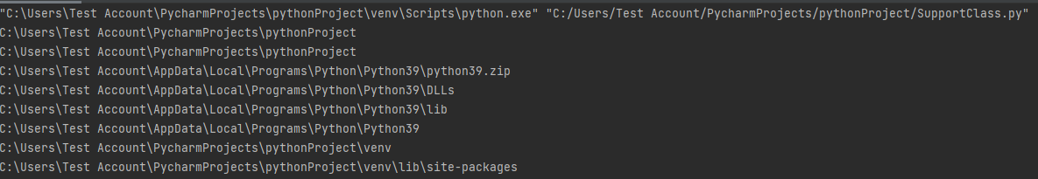
Module search path
import sys
for path in sys.path:
print(path)
Python stores the resulting search path in the sys.path variable that comes from the sys module.

Slide 12
THANK YOU
www.skillslash.com

